Slide 1



Operator’s Manual
The Disability of Glare
GLARE TESTER
Brightness Acuity Meters:
  BAM Spot™
  BAM Flood™
Document & Demonstrate
Disabling Glare
for
Timely Surgical Intervention
BAM Flood™: Floodlight Glare
Normal
Cataract
simulated
BAM Spot™: Spotlight Glare
Hand-Held Glare Test
~ Measure with Confidence ~
E
E
E
E
E
E
Normal
Cataract
simulated
AMA Optics, Inc.
11 ISLAND AVE
SUITE 1001
MIAMI BEACH, FL 33139
(786) 387-4834
www.amaoptics.com www.visionperformance.store
U.S. Patents 7,857450 & 8,038,297

Slide 2
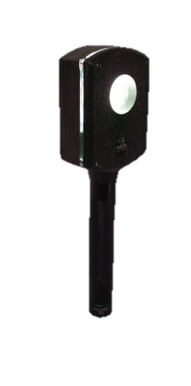
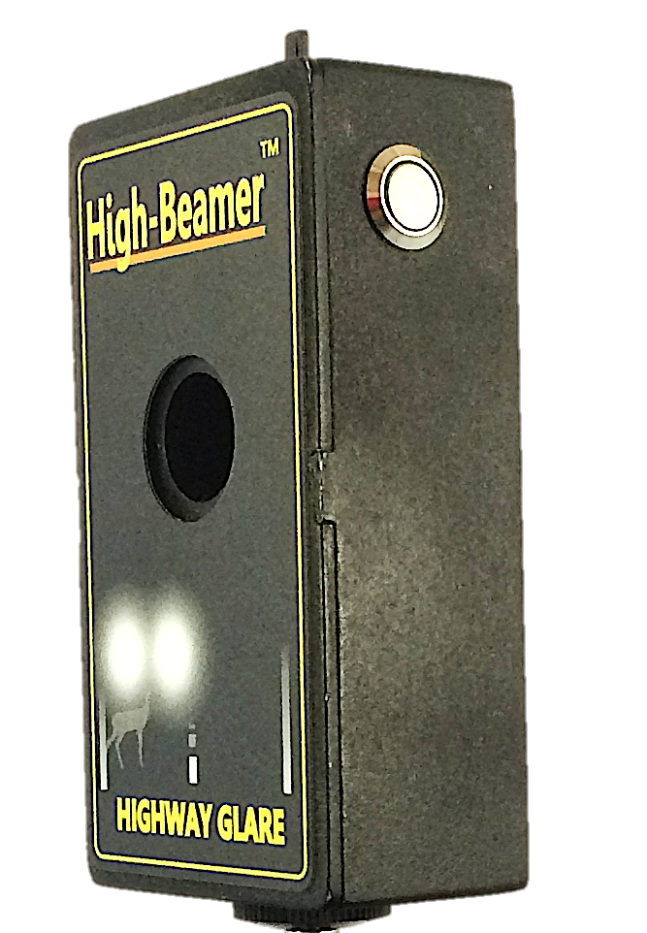
Using the RAM® Prime XL as the vision chart for glare testing
Qualifies for surgery
Qualifies for surgery
Comparison of BAM Flood™ to RAM Spot™
  78 year old with cataract OS > OD and complains of glare from headlights. Green line indicates the threshold for qualifying for cataract surgery as per Medicare Guidelines, i.e., worse than 20/40 with glare test. BCVA is 20/20 OD and 20/30 OS and both eyes qualify for cataract surgery because of glare.
BAM Spot™
BAM Flood™
Packing List
BAM Spot™ or BAM Flood ™
2. Battery included
3. Lens Cloth
5. Operating Instructions
Optional item:
Lens Holder for refractive correction
Two slots for sphere and cylinder
Marked in degrees
The RAM® Prime XL fitted with the reading chart and the brightness set at 85 cd/m² (dim) can be used as the vision chart at near for BAM testing. Any vision chart may be used, remember too bright of a chart will nullify the glare effect.

Slide 3
INTRODUCTION
AMA Optics glare testers measure car headlights and sunshine glare. The main application of the glare testing is to demonstrate, document, and monitor disabling glare, information that can assist in timing of cataract surgery or capsulotomy.
Medicare Guideline for Timely Invention
“Coverage for cataract extraction is indicated if there is a glare component, glare testing which reduces visual acuity to less than 20/40.” Check with your insurance provider for specifics rules in your region.
AMA Optics, Inc. Glare Testers
BAM Flood™ (Floodlight Acuity Meter)
Mimics sunshine streaming through a picture window
2. BAM Spot™ (Spotlight Acuity Meter)
Mimics car headlights, aka “ High-Beamer™”
Why test for Glare? How do the testers work?
Glare can be very dangerous and disabling for those having cataract, posterior capsular opacity, or corneal opacities. In most cases early cataract surgery or capsulotomy cures the problem. The most common glare complaint is the fear of having an accident at night due of the blinding glare from on-coming automobiles. Accidents occur because pedestrians, animals or cars in-front or on the-side-of-the-road are invisible due to blinding glare from car headlights.
If a glare standard was established for driver’s license, nighttime accidents would certainly be reduced.
Bright sunshine is another common source of glare complaints. Sunshine streaming through the window can be annoying during work or social situations.
Key to diagnosing the presence and documenting the severity of disabling glare is Glare Testing. AMA Optics markets two Hand-Held glare testers, the BAM Flood™ and the BAM Spot™. The BAM Flood™ generates floodlight glare and the BAM Spot™ generates spotlight glare.
The principle behind both the BAM Flood™ and the BAM Spot™ is similar: In a light scattering medium, the brighter the light the more the light scatters and the more visual acuity degrades. In an eye with no disease and no light scatter, glare testing does not significantly reduce vision. However, in an eye with light scattering cataract, posterior capsule, or corneal disease even a slight increase in brightness can cause drastic vision loss. The test is simple: (1) test the Snellen acuity under normal lighting, (2) test the Snellen acuity while viewing through the glare tester, and (3) compare the results. In USA, when glare testing reduced the vision to less than 20/40, glare is considered significant, and generally qualifies for cataract surgery.

Slide 4
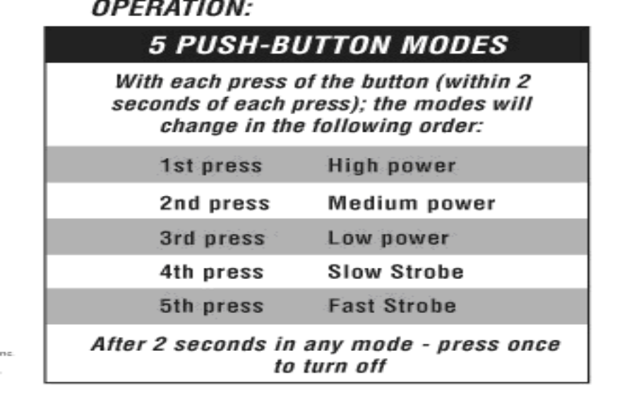
The BAM Flood™ displays a uniform bright field of light produced by a single LED bulb illuminating a white reflective bowl. The BAM has three brightness settings (Low, Medium, High) controlled by a single push-button IQ switch.
The BAM Spot ™ (High-Beamer™) displays two lights, one on either side of the line of sight that mimics on-coming headlight. The lights are two side-side 2 mm LED bulbs. A potentiometer with a digital readout allows dial-in precise illumination anywhere on the scale of Low to High brightness. The chart on page 5 shows the linear relationship between voltage and brightness (kLUX).
Both the BAM Flood™ and BAM Spot™ are effective, lightweight, easy to use Glare Testers where the BAM Flood™ mimics floodlight glare and the BAM Spot™ mimics spotlight glare or headlights of an automobile.
GLARE TEST
An illumination source can adversely reduce visual acuity by degrading image resolution when a light scattering eye condition exists. The adverse effect of glare on visual acuity is measured with the BAM Flood™ and BAM Spot™.
Conditions causing glare:
♦ Corneal opacities or corneal edema
♦ Cataract
Clouding of the posterior lens capsule
Opacities in the vitreous
♦ Scratched or dirty glasses or contact lenses
Brightness Setting: BAM Spot™
Brightness level is adjustable using a potentiometer switch with 1, 2, or 3 levels or infinite levels while observing the digital voltmeter reading. A linear relationship exists between voltage and brightness in LUX.
Brightness Setting: BAM Flood™

Slide 5
Vision Chart
Any vision chart can be used but it is important that the chart luminance be of standard brightness, 85 cd/m². A bright chart may give false negative glare testing results.
Glare Testing – preparations & instructions
Do not dilate the pupil prior to testing.
Inspect the patient’s glasses or contact lenses for
debris or scratches that could interfere with glare
testing and give a false positive result..
♦ Instruct the patient to hold the BAM Spot™ or BAM Flood ™ close to their eye, glasses or the Carrier Frames.
BAM Spot ™: The Off-On switch is both momentary and latching, gentle pressure on the switch turns on the light for a momentary view, deep pressure (use the little finger) on the switch locks it ON. Move the slider on top to change the brightness.
BAM Flood ™ : Press the IQ switch once for High, twice for Medium and three times for LOW
Testing can be individualized. One method is to set the vision chart to the 20/40 lines and start with the BAM on LOW. Increase the brightness until the patient is unable to read the letters. If the 20/40 line is read at the HIGH setting, glare does not justify cataract surgery. When the patient is unable to read the 20/40 line, record the setting of the BAM Flood ™ or BAM Spot ™ for documenting the justification for cataract surgery.
BAM Spot™: The power readout is in volts and related to brightness in LUX as shown below.
Low.… Medium......High
Linear relationship exists between Volts and LUX.
The formula, kLUX = (0.217 x VOLTS) – 0.4756 conversion of volts to kLUX .

Slide 6
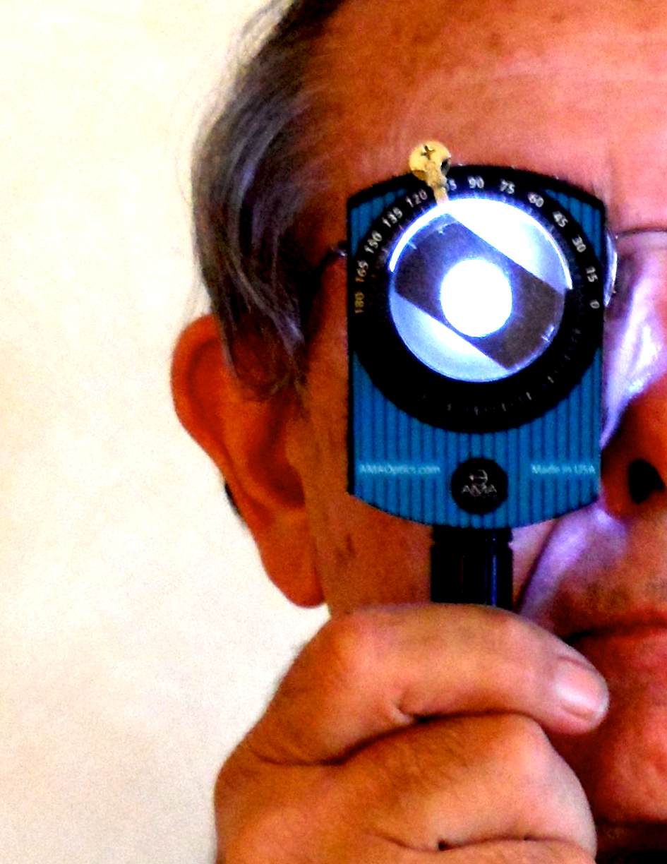
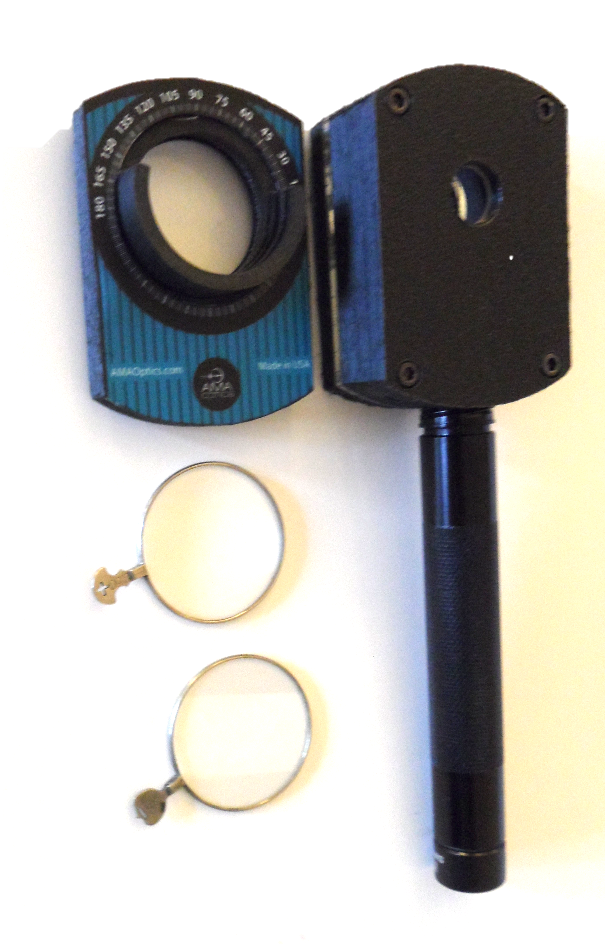

Optional Trial Lens Holder
The lens holder attaches to the BAM by four tiny magnets and is held securely in place. The spherical and cylindrical lenses snap into place and can be easily rotated to the desired axis. Lenses attach distal to the glare light and do not artificially increase glare. Lenses may represent full refraction, over-refraction, or near add. Trial lenses are not included with the glare tester.
Technical Data for BAM Spot™
Weight 6 ounces
Power: 9 Volt battery
Digital voltmeter shows power status
Digital voltmeter equates to light brightness
Two 2 mm L.E.D bulbs
Illumination
Adjustable Low to High brightness
Brightness: 0.20 to 1.35 kLUX, measurements taken at the viewing port.
Battery Power Level
Change or charge the battery when the voltmeter reading nears 7.2 volts
Battery Changing (any 9 Volt Battery)
Place fingernail below clip, depress and pullout
Slide tray completely out
Press through the bottom tray opening to eject the battery
Replace with new 9 Volt battery or recharge if rechargeable
Connect battery to terminals before putting in the tray
Slide battery into tray with connectors aligned* with slots
Insert tray into BAM Spot™
Warranty BAM Spot: Three Year, parts and labor
Technical Data BAM Flood™
Weight 6 ounces
Power: 2 AA alkaline batteries
1 watt L.E.D LUXEON® bulb.
Factory calibration is recommended yearly.
Illumination
IQ Switch® with three brightness modes: High, Medium and Low (push button in quick succession to achieve desired level)
1 click = High Setting: 2.2 k lux.
2 clicks = Medium Setting: 1.1 k lux.
3 clicks = Low Setting: 550 lux.
Warranty BAM Flood: One Year, parts and labor

